Slide 1
What Is Kernel?
A kernel is a central component of an operating system. It acts as an interface between the user applications and the hardware. The sole aim of the kernel is to manage the communication between the software (user level applications) and the hardware (CPU, disk memory etc).
The main tasks of the kernel are :
Process management
Device management
Memory management
Interrupt handling
I/O communication
File system...etc..

Slide 2
Types Of Kernels
Kernels may be classified mainly in two categories:
Monolithic
Micro Kernel
Hybrid Kernels
Nano Kernels
Exo Kernels

Slide 3
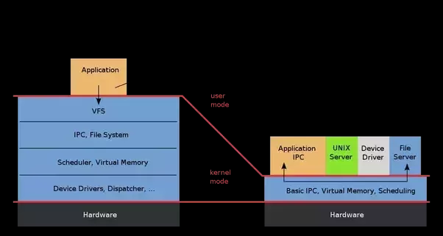
Hybrid Kernel: It combine aspects and benefits of micro kernel and monolithic kernel architectures.

